Slide 1

P peline
The Data
Practical Issues in Acquiring Data
© Jennifer Mankoff
The Data Pipeline; HCII; Spring 2014

Slide 2
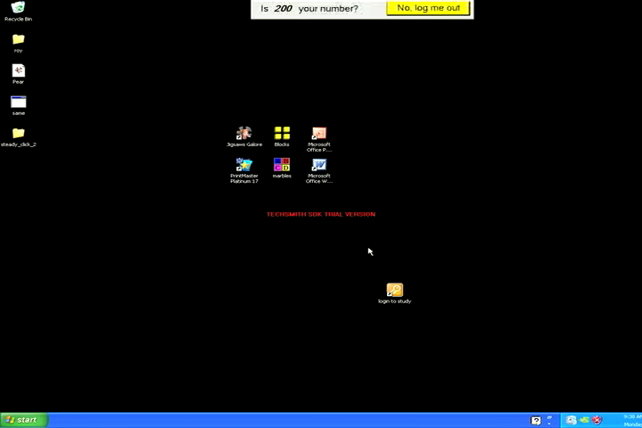
Course Example: Pointing Problems
Attempt to double-click desktop icon
Duration: 1 minute 40 seconds
Notes:
(PAUSE TO MAKE SURE VIDEOS PLAY) Here we see Annie attempting to activate a desktop icon. The video on the right shows her attempts to activate this desktop icon, and is unedited and lasts 1 minute, 40 seconds. The video on the left cycles through 3 clips that illustrate her two main pointing problems: slipping off a target (which she did 5 times) and difficulty smoothly moving the cursor making sporadic movements.
IF video doesn’t play go back to previous slide

Slide 3
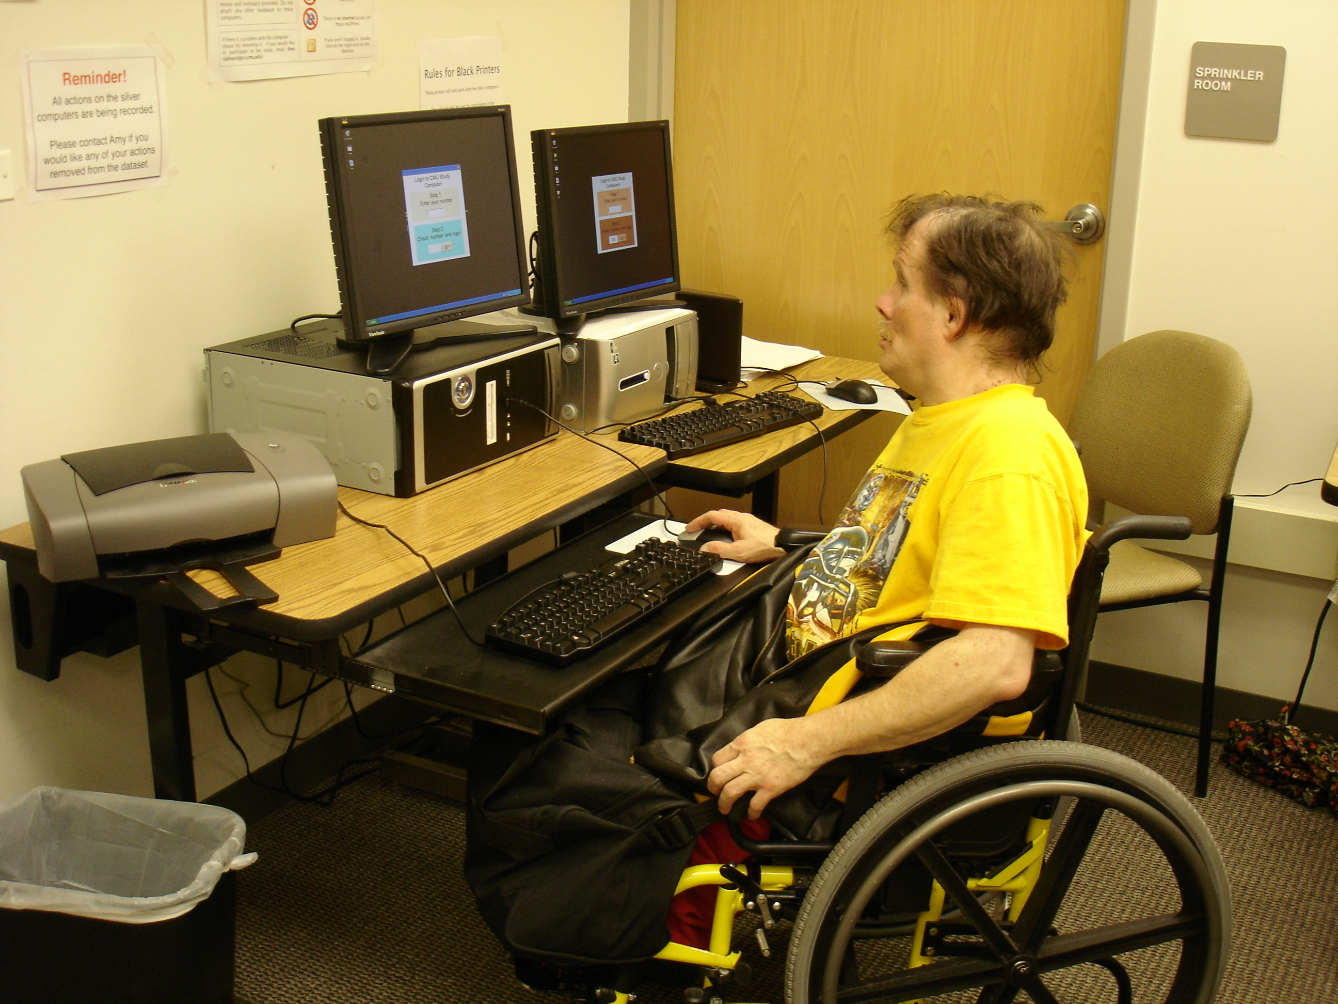
Large Real World Datasets
United Cerebral Palsy Pittsburgh
(08-10) 12 participants
Collected hundreds of hours of real world data from 27 people with and without pointing problems
Websurfing, socializing (email, instant messaging, social networking websites), homework, and video games
Both desktop and laptop usage
Notes:
Collected hundreds of hours of real world use from 27 people with and without pointing problems
We ran our pilot study at UCP Pittsburgh, and installed two desktop computers in a pre-existing computer lab. Participants were able to use these computers whenever they wanted (during a class or their free time) and perform any tasks they wanted. These computers are still collecting data at UCP, and for the first year of this study, they did not have internet access.
We recruited twelve participants with pointing problems due to motor and/or cognitive impairments for this pilot study

Slide 4
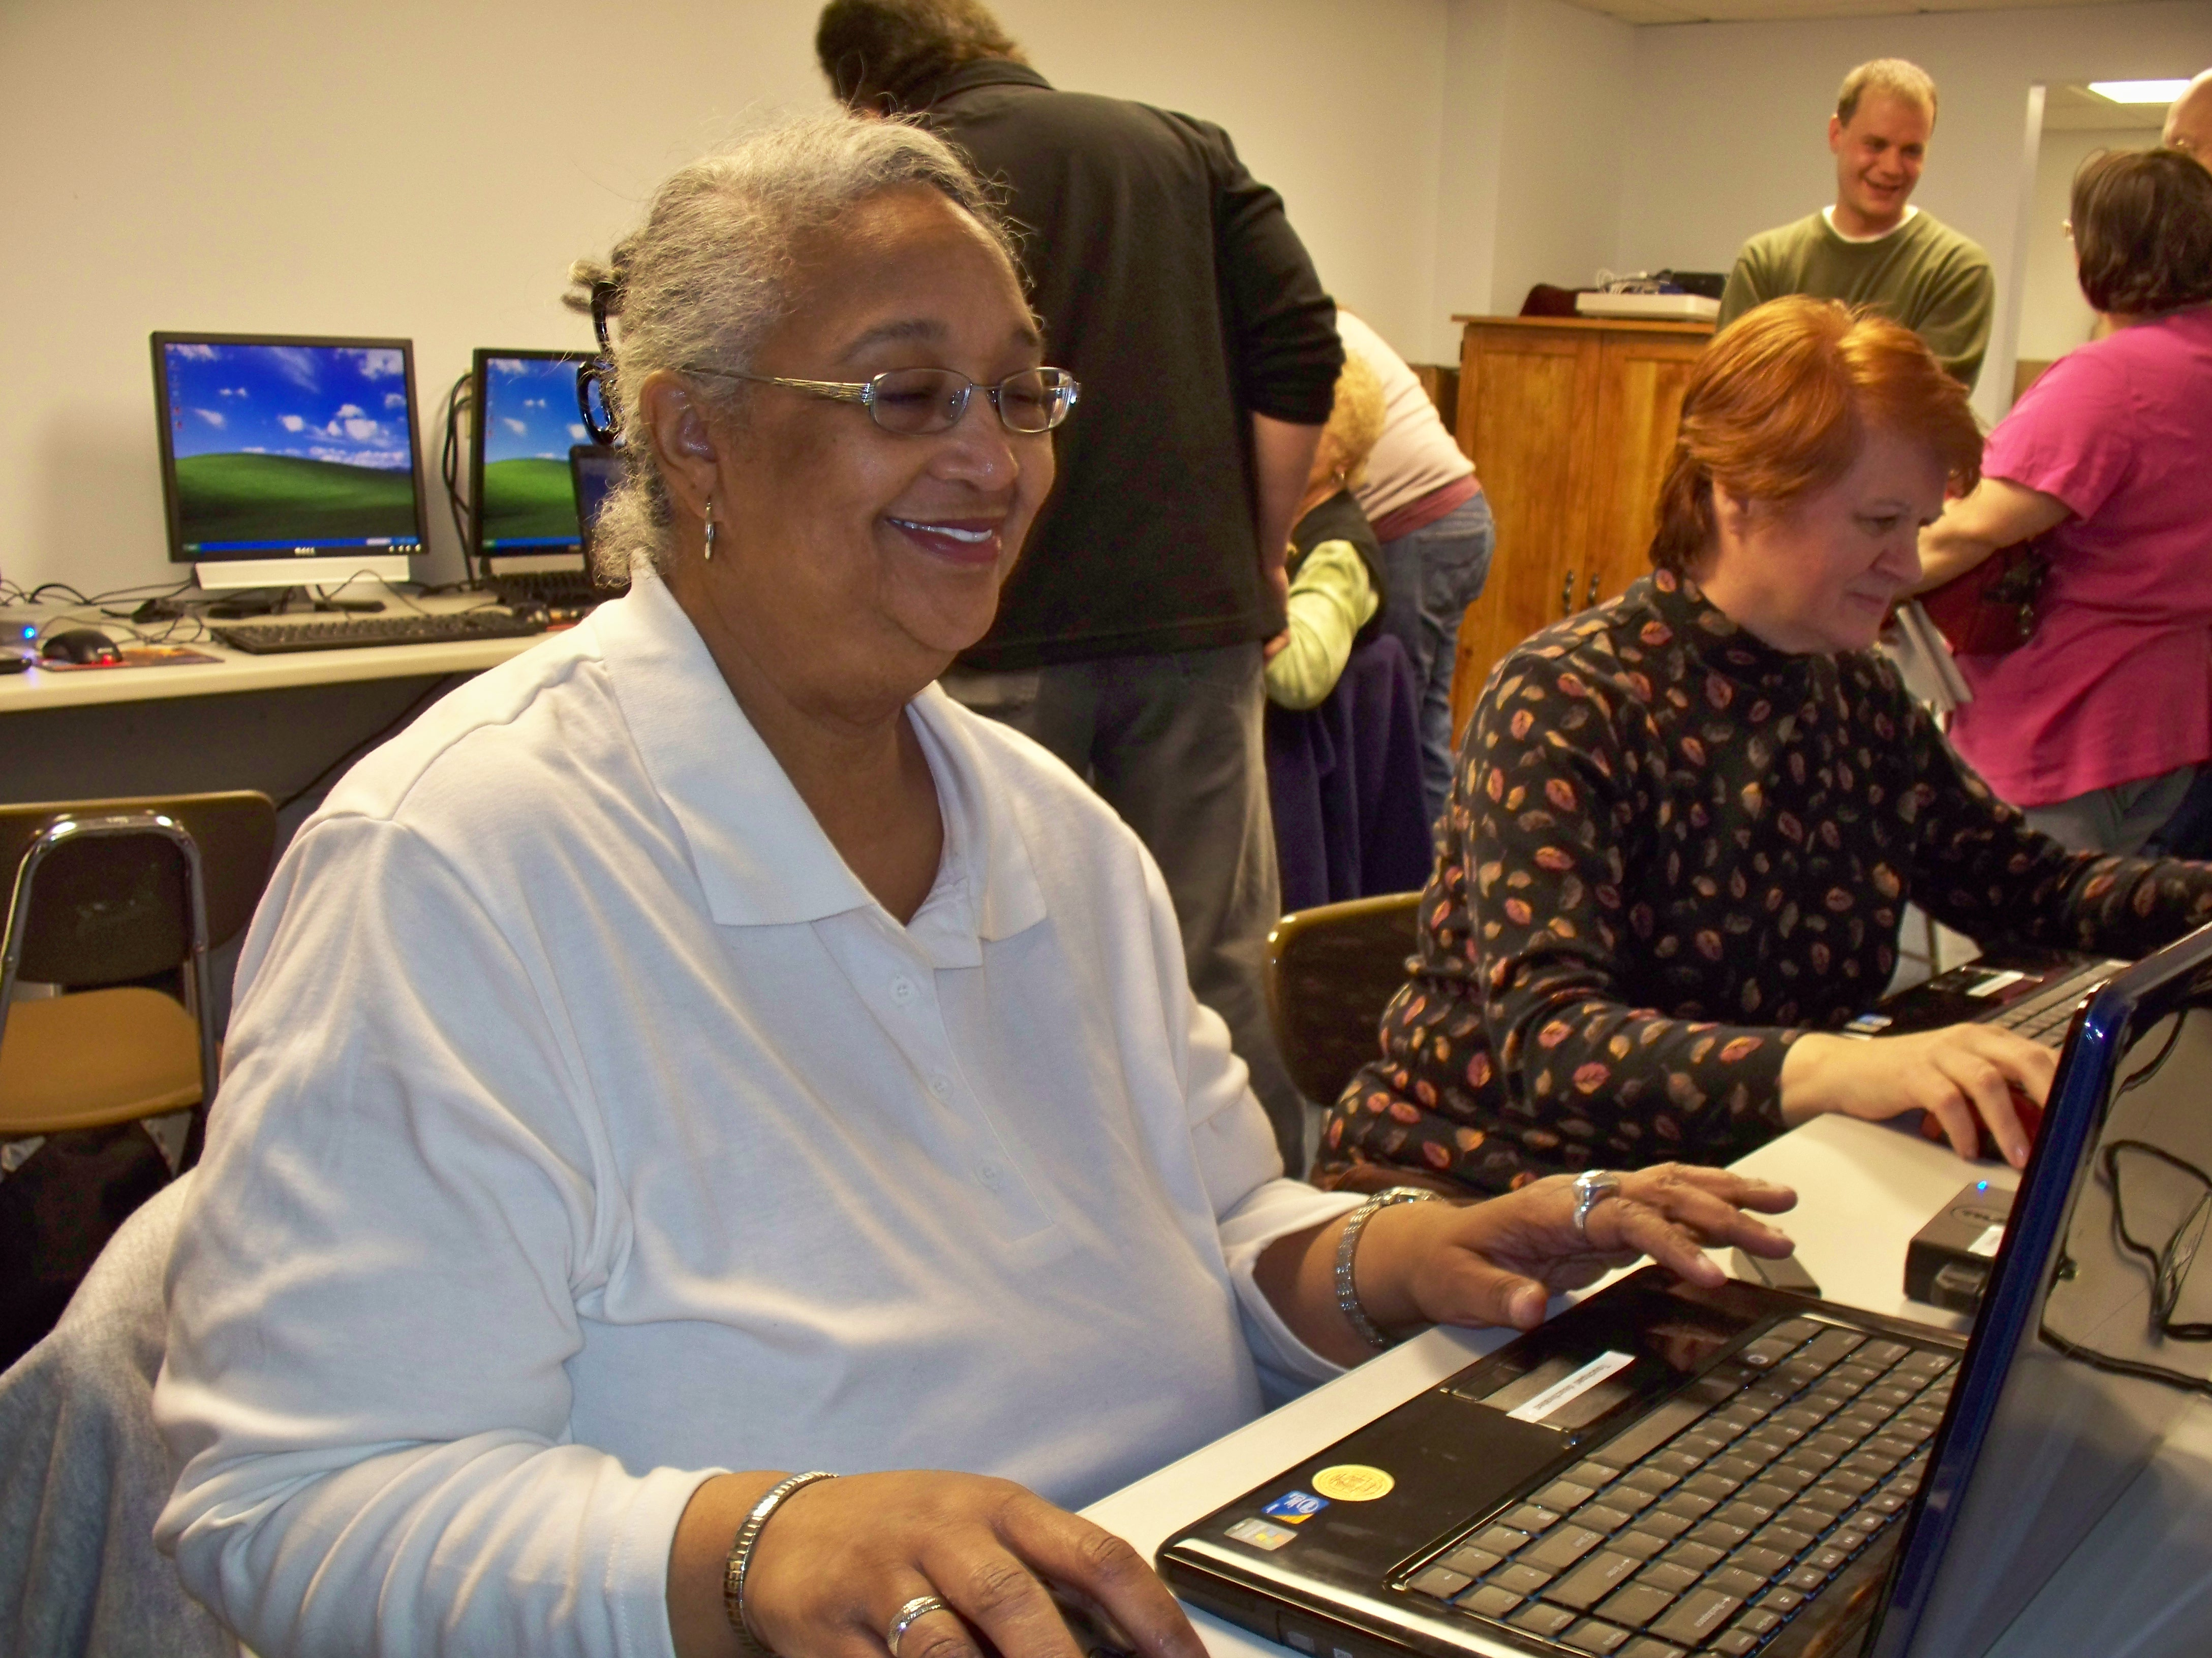
Laptop Deployment: Multiple Groups (July 09 – 10) 17 participants
 | Participants | Female | Average Age | % data collected
Able | 4 | 1 | 29.25 | 22.87%
Older Adult | 8 | 8 | 67.63 | 69.15%
Motor Impaired | 4 | 2 | 41.75 | 7.99%
Notes:
We have been collecting real world data using laptops for almost a year. In this study, we give our participants identical hardware: a DELL laptop with an external USB mouse. Participants who did not have access to the internet at home or work, received a wireless modem.
<click>
Our laptop deployment includes 4 individuals with motor impairments (2 of whom were also in our desktop study), 4 able bodied individuals (we recruited from CMU through a newsboard advertisement), and 8 older adults (a group of women who have known each other for years, are mostly computer novices, and meet monthly at Blueroof Technologies).
70% of the data we collected was from older adults – and most of this was game data (such as freecell, spider solitaire, mahjonng etc). Overall, over 50% of all data collected was from games, and 25% from Internet use.
----
Traumatic Brain Injury, occasional tremor
Cerebral Palsy, Spinal Cord Injury, Traumatic Brain Injury
Paralyzed from the waist down, memory and motor impairments (including an intermittent tremor).
Cerebral Palsy, arthritis, upper extremity impairment, cannot move right limb.

Slide 5
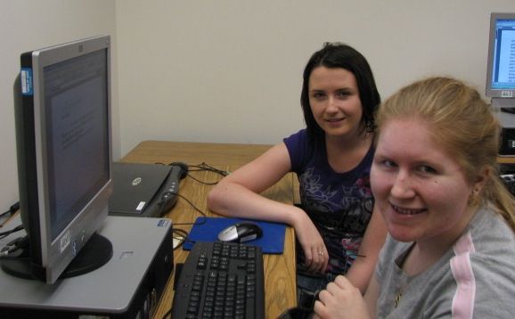
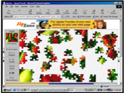
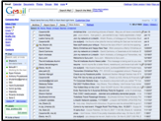
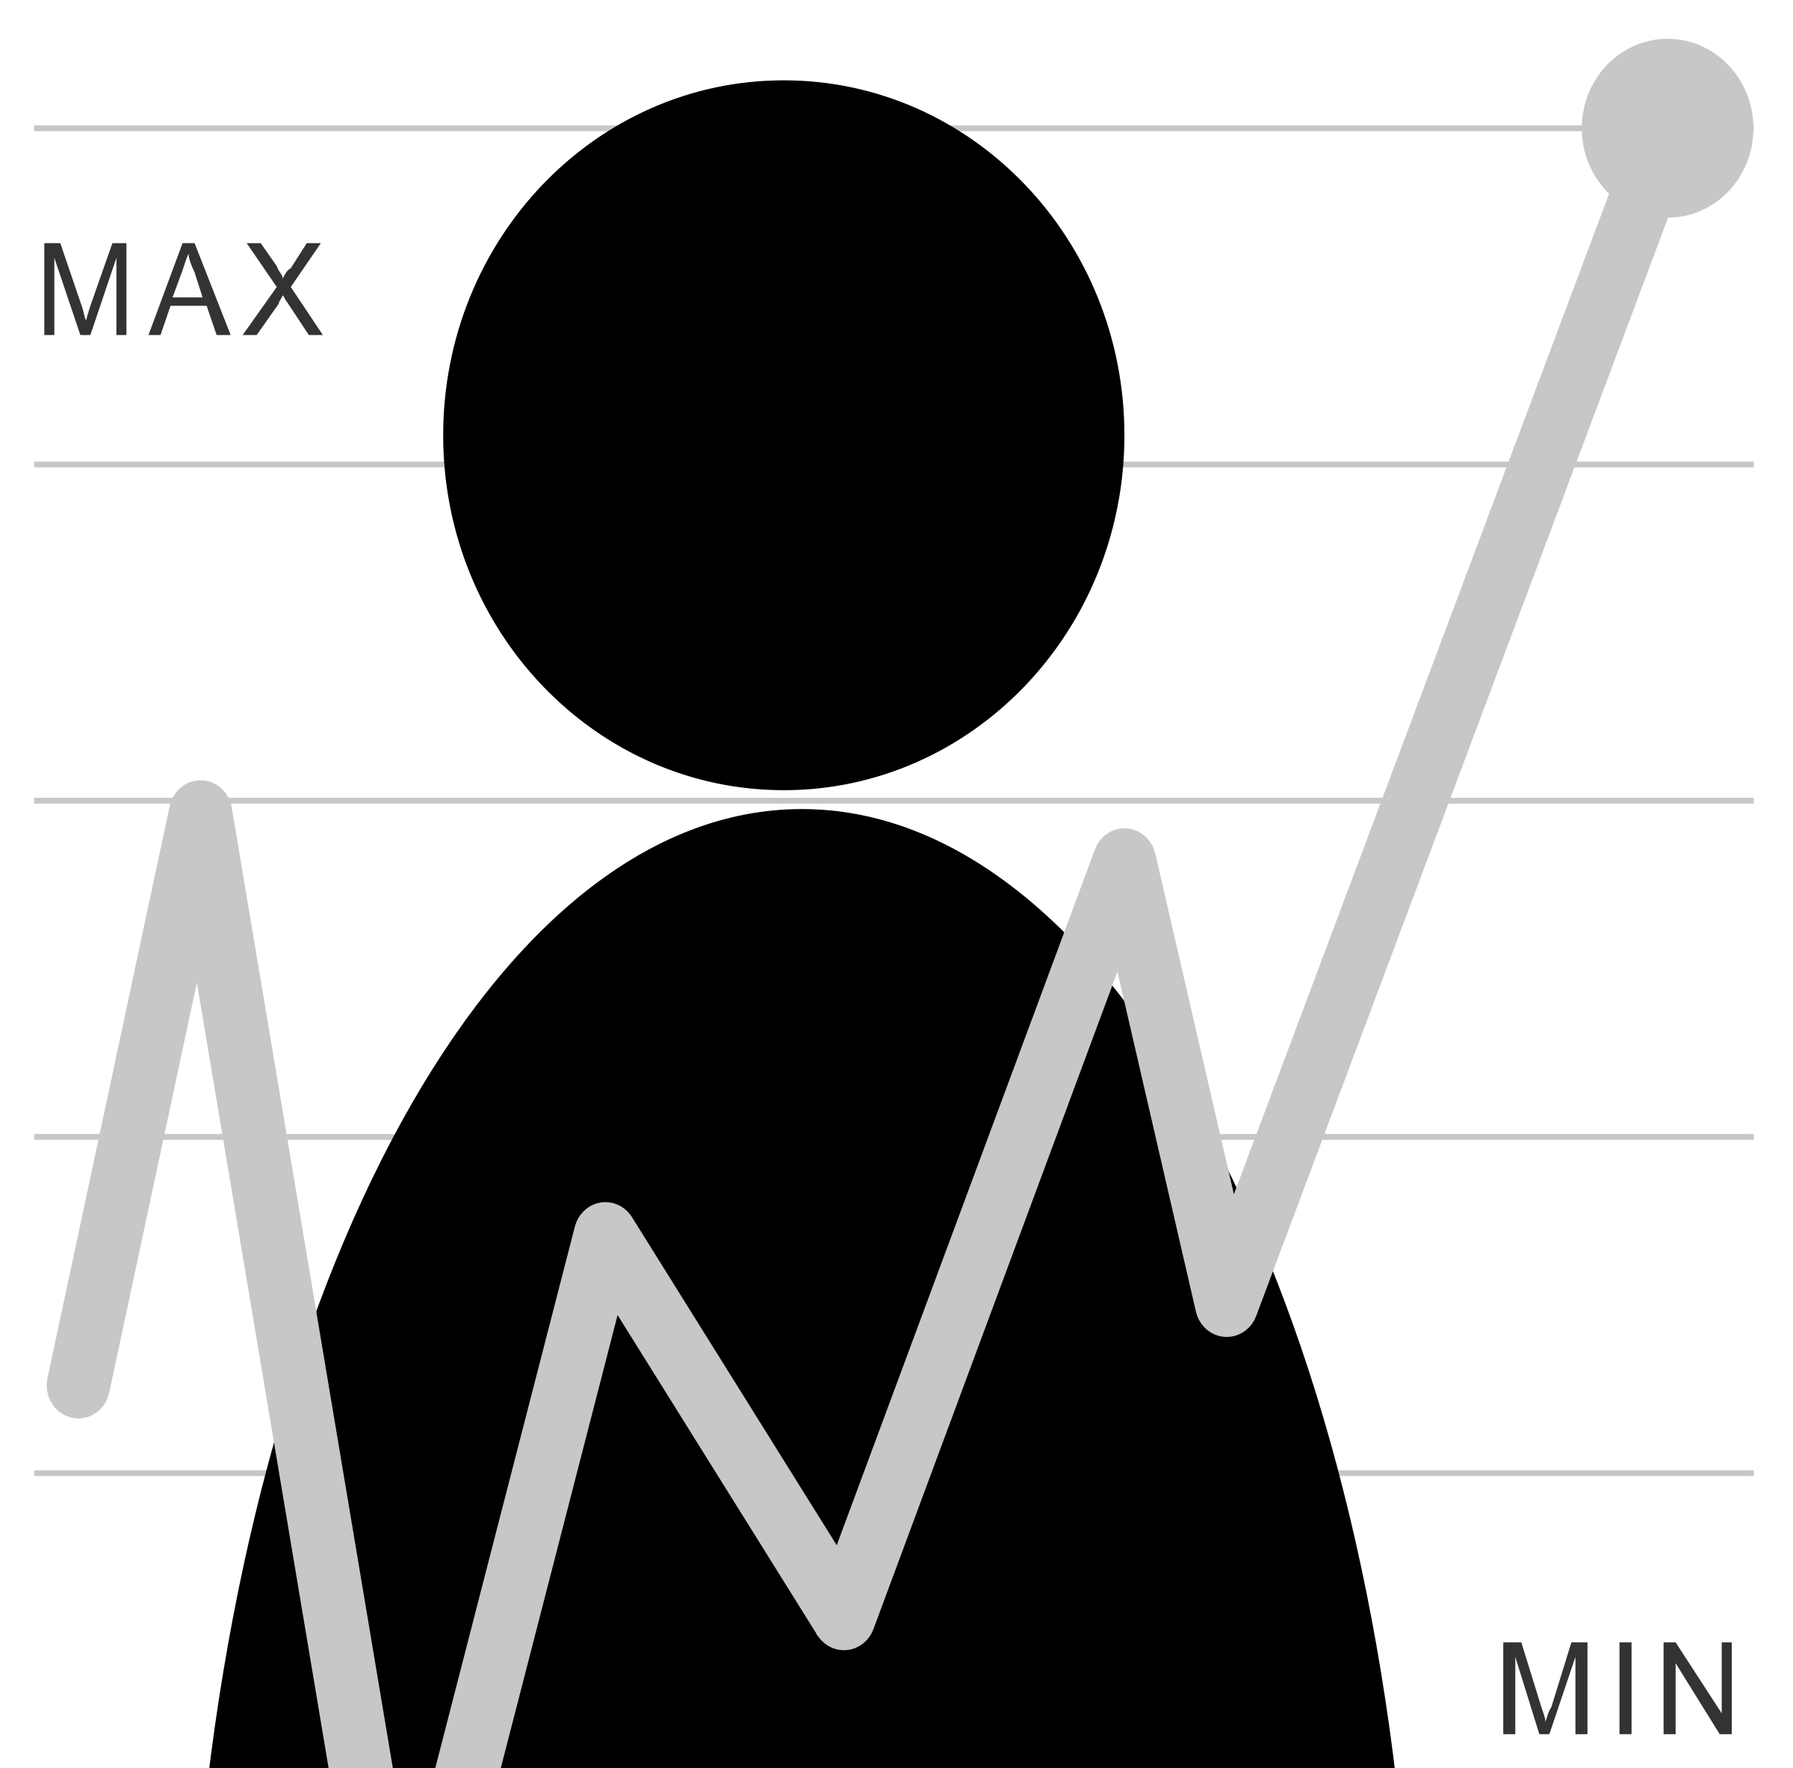
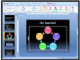
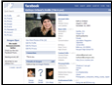
Human Issues in Data Collection
Unobtrusive logging software
Participant has full control over study logistics
Task
Collected information
Frequency and duration
Desktop and laptop use
Notes:
We use the following study design collect real world pointing data: We lend computers to our participants that run our unobtrusive logging software (will describe on the next slide). During our first meeting we perform a traditional laboratory clicking task, after that, participants have full control over all study logistics. They have the freedom to choose what they do with the computers, when the logging software is on, how frequently they use the computers, and they also get to decide the duration of any given session.

Slide 6
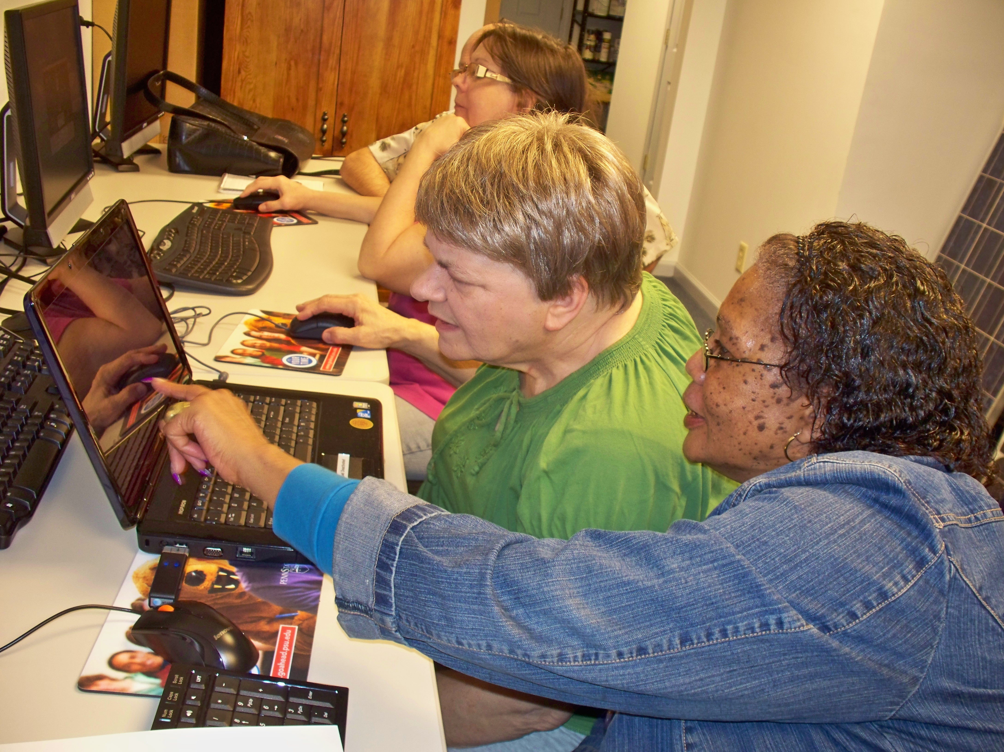
Group Support
Notes:
We found that our study protocol worked for all three populations. We believe that this protocol worked particularly well for our older adults and motor impaired participants because they had external support.
The older adults in our study frequently worked together and taught each other how to use the computers (both during their monthly meetings at Blueroof and outside these meetings).
Our motor impaired participants at UCP received support from the staff there who would help them set up the laptops, and allowed them to use their laptops during classes.

Slide 7
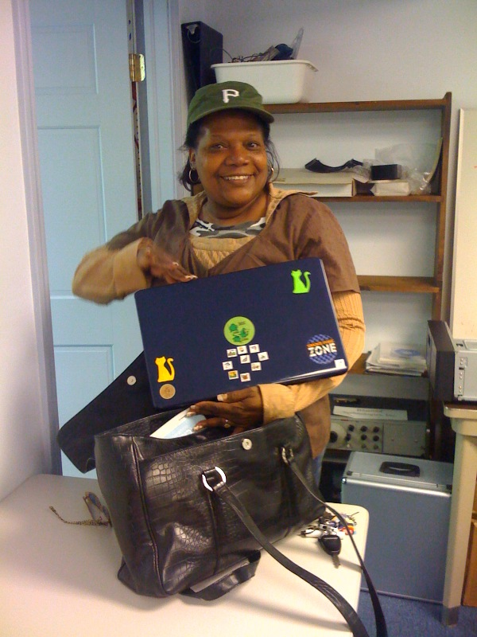
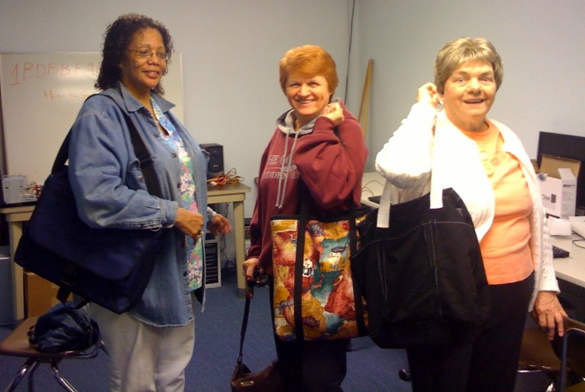
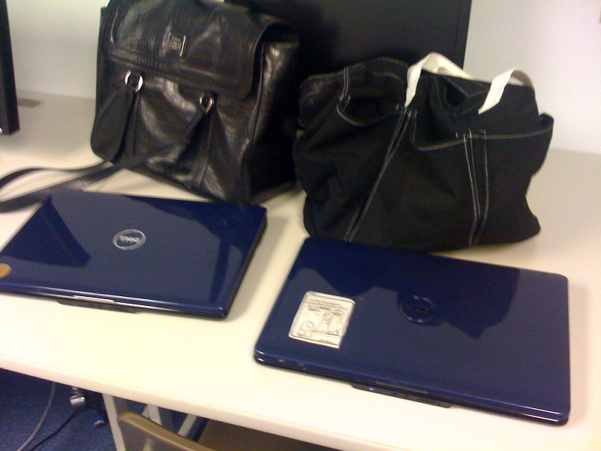
Attachment and Personalization
Notes:
In general, participants were pretty enthusiastic about being in this study – likely because they were excited to have access to a laptop. We also we found our participants used these laptops as if they were their own: they decorated them, and carried them around in unique bags.
I really enjoyed conducting this study because I got to see how much of a positive impact these laptops had on our participants lives, and watch many of our participants learn how to use computers.

Slide 8
A first look at the data

Slide 9
Amy’s Mouse Data: Text log files
0,0,CBT:-- --( )--6:5.23:468--Window Created
0,0,CBT:-- --( )--6:5.23:562--Window Created
0,0,CBT:-- --( )--6:5.23:578--Window Activated--(HCII Logging Setup Screen)--main size:--(556,309)--location:--(405,212)
0,0,CBT:-- --( )--6:5.23:609--Window Created
0,0,CBT:-- --( )--6:5.23:609--Window Created
0,0,CBT:-- --( )--6:5.23:609--Window in focus--gotFocus--size:--(445,39)--location:--(500,0)
0,0,MOUSE:----()--6:5.24:46--(457, 545)--MOUSE MOVED--time:--45640--0--0
0,1,CBT:-- --( )--6:5.24:62--unrecognized symbols--unknownWinEvent--size:--(445,39)--location:--(500,0)
0,1,CBT:-- --( )--6:5.24:78--unrecognized symbols--unknownWinEvent--size:--(445,39)--location:--(500,0)
0,1,MOUSE:----()--6:5.26:250--(457, 543)--MOUSE MOVED--time:--47921--0--0
0,2,CBT:-- --( )--6:5.26:250--unrecognized symbols--unknownWinEvent--size:--(445,39)--location:--(500,0)
0,2,MOUSE:----()--6:5.26:250--(457, 543)--MOUSE MOVED--time:--47921--0--0
0,3,MOUSE:----()--6:5.26:265--(458, 541)--MOUSE MOVED--time:--47937--0--0
0,4,CBT:-- --( )--6:5.26:265--unrecognized symbols--unknownWinEvent--size:--(445,39)--location:--(500,0)
0,4,MOUSE:----()--6:5.26:265--(459, 539)--MOUSE MOVED--time:--47937--0--0
0,5,CBT:-- --( )--6:5.26:265--unrecognized symbols--unknownWinEvent--size:--(445,39)--location:--(500,0)
0,5,MOUSE:----()--6:5.26:281--(460, 535)--MOUSE MOVED--time:--47953--0--0
0,6,CBT:-- --( )--6:5.26:281--unrecognized symbols--unknownWinEvent--size:--(445,39)--location:--(500,0)
Notes:
Major parsing effort to create tables!
The original logs did not have consistent logging formats and improper delimiting which has resulted in issues with parsing. Some of these have been fixed, but others may not yet have been found. Typical symptoms include the subfields not correctly matching the expected value from the original log file. Typical errors are caused by log file field delimiters appearing within a field (causing incorrect field tokenization). Other errors caused by unknown and inconsistent log line formats. Different types of log lines had differing line formats and these sometimes changed.

Slide 10
Unlike laboratory data,
real world data is not easily segmented by task
Notes:
Analyzing real world data is more complicated than analyzing laboratory data. One reason is that laboratory log data is typically “segmented” by task (or intent) which is usually clear because the experimenter tells the participant what to do. However, when studying real world data, we do not know the user’s tasks and the only information we have to work with are long logs of event data.
Since we don’t know intent, we segment data according to events captured by CRUMBS that are relevant to the assessments we want to make. In this thesis we focus on targeting motions, so we segment data by button events and pauses.

Slide 11
Also there are lots of anomalies
Notes:
Removed samples with more than 10 minutes of pause data
Removed windows and targets that were larger than 2000 pixels

Slide 12
And unexpected differ- ences that made analysis difficult
Notes:
Application popularity differed a lot from group to group

Slide 13
Four C’s of Data Quality
Is your data Complete?
Is your data Coherent?
Is your data Correct?
Is your data aCcountable?

Slide 14
Recommended Reading
The Bad Data Handbook (McCallum): O’Reilly Press
Making Sense of Data: A practical guide to Exploratory Data Analysis and Data Mining
Tukey: Exploratory Data Analysis

Slide 15
But first… What type of data do you have?
How is it structured; if at all?
Does it have multiple tables or just one?
Is it designed for machine consumption or human consumption?
Is it in a database? multiple files or one file?
How are missing values represented?
What are the fields and values?

Slide 16
Amy’s Data Tables
One-time & Qualitative data about participants (participant number; ‘diagnosis’; performance on initial test; etc)
Session data (summary)
Event data (details)
Segment data (summary)
Keyboard key down (if any)?
Mouse features
Target features
…

Slide 17
What if you are using someone else’s data?
http://data.cmubi.org/classroom-news/somegreatsourcesofdata
Web APIs
Programmatic interface to server side data and functionality
We like REST APIs best
http://en.wikipedia.org/wiki/List_of_open_APIs
http://www.programmableweb.com/apis/directory
http://www.webdesignerdepot.com/2011/07/40-useful-apis-for-web-designers-and-developers/
https://www.data.gov/developers/apis
Notes:
Api cons: Things can change
Much less bad than scraping though!

Slide 18
What Type of Data in Each Field?
Constant (e.g., mouse gain)
Continuous Data (e.g., mouse location)
Discrete Data (often scales)
(e.g., slip/no slip on this interaction)
What are the units?
Notes:
Interval: Scales that describe values where the interval between the values has meaning.
Ratio: Scales that describe variables where the same difference between values has the same meaning (as in interval) but where a double, tripling, etc. of the values implies a double, tripling, etc. of the measurement. An example of a ratio scale is a bank account balance whose possible values are $5, $10, and $15. The difference between each pair is $5 and $10 is twice as much as $5. Since ratios of values are possible, they are defined as having a natural zero.

Slide 19
What Role Does This Field Play?
Descriptor / Feature: predictive of labels (e.g. Click Duration)
Response / Label:
outcome of prediction
response to an intervention / question
(e.g. Diagnosis)
Notes:
Example scripts to address each of these?

Slide 20
Questions about Completeness
Appropriate Data: Does the data you have match the questions you want to answer?
Missing Data: Data does not exist because it was never obtained or was lost
Reporting error: The sensor (or respondent) is incorrect
Notes:
Look ahead … to the questions you’d like to answer
Reason back … to the data you’d need to collect

Slide 21
Solutions and Issues for Missing Data
Impute the data using statistics
Find an alternative source
Reweight the data to reflect the changed sample
Notes:
Example: we had data files whose names matched one participant but the directories matched a different participant name. The directories were done by hand, the file names were machine-generated. Which would you trust?

Slide 22
Is your Data Coherent?
Does the data “add up”?
Does it make sense relative to itself?
Are the extreme values?
Examples
Non number in a numeric field
Month field has something other than a month
Email has no @
Hourly data adds up to 24 hrs per day
Etc.

Slide 23
Nominal/Ordinal Field Data Inspection
How many are there?
Are they spelled consistently?
What is the frequency distribution of different values?

Slide 24
Interval/Ratio Field Data Inspection
Calculate min/max/mean; Make graphs!
- are there unexpected negative values? Very large targets/long motions/low velocity?
What outliers do you have?
- could represent measurement errors
- could be genuine
Do you have unexpected patterns
- can you see unexpected patterns (e.g. due to clutching)
Notes:
Need domain expertise to differentiate!

Slide 25
How do we address extreme values?
Outlier Treatment
Can drop them
Winsorization (replace with a less extreme value)
Replace missing value with a default. 0 was my default solution in explore.py
De-Duplication
Domain-based adjustments

Slide 26
How to detect and quantify skew?
A vector denoting presence/absence/percentage of data in each entity (location/person) ➔ glitch signature
Outlier detection techniques
Summary statistics
Graphs and Charts
Notes:
A value dij ∈ D is “clean” if and only if every value in vij is zero, that is the sum of the bits is 0. Glitch signatures can be considered augmented or derived data that enable us to flag glitches, quantify their prevalence, and identify patterns in an analytic, automated fashion.

Slide 27
Did we improve things?
Compare glitch index (sum of glitch signature) before and after
Check for statistical distortion (measure the distance from D to D*

Slide 28
Is your data Correct?
Are the values correct?
Itemize aspects of your data that are easy to verify
Determine which are important
Understand how much of your data may be incorrect
Decide what to do with bad data
Other sources of error:
Proxy reporting: Making use of one sensor (or respondent) to fill in for another
Sampling biases…
Notes:
How does correctness differ from coherence? Correctness asks whether its representation of the world is close to how the world actually is…

Slide 29
Detect Errors
Analyze the data collection strategy and look for sources of bias
Within the population
across variables (surveys with only round values; people who report everything in round numbers)
Collect the data twice and compare
Find an alternative source to compare

Slide 30
Draw from many sources
Do the values match your understanding of the units?
Do they match past work? Keates (2005): Able ~112; Older 271; Motor 316
 | Game |  | Internet |  | MS Office
 | Mean (ms) | SD | Mean (ms) | SD | Mean (ms) | SD
Able |  |  | 147.236 | 15.912 | 128.526 | 10.1733
Older | 226.845 | 72.801 | 221.076 | 63.239 | 163.282 | 30.4858
UCP | 406.756 | 285.245 | 391.059 | 128.410 | 290.252 | 74.4451
Notes:
Example scripts to address each of these?

Slide 31
Quantify Impact
Are errors random or do they introduce bias
Are errors more likely in some variables than others
Is there a specific type of error you expect?
Can you go to the source and ask about error?

Slide 32
Is your Data Accountable?
Do you understand the provenance of the data?
Have you protected any end users or other people who could be traced?
Can you back up your claims about the data?
Do you have the original data as well as any modifications (version control?)
Who has access to the data?

Slide 33
Example analysis of 4 Data Sets
 | Augsburg Occupancy | CMU Occupancy | UCSD Movement | CMU Movement
Collection Method | Smart Door Plate | BACNet Sensor Queries | PDA-based WiFi triangulation | Phone-based WiFi Triangulation
Frequency | Every Room Change | Every 10 minutes | Every 20 sec | Every 30 sec, while movement is detected
Flaws | Summer and Fall data sets 4 month apart
Room vs. Floor vs. Campus | Covers 1 floor in an office building | Covers every floor in one university office building | Covers several campus buildings | Covers every floor in one university office building
Type | Transitional | Occupancy | Tracking | Tracking

Slide 34
Four Data Sets
 | Augsburg Occupancy | CMU Occupancy | UCSD Movement | CMU Movement
Scope | 4 People, (summer + [break] + fall) | 300 data points per day per room (temp & occupancy) | 275 students, M=11 weeks | 6 People
Total locations | 15 | 293 Rooms | 200 | 2074 (10x10 meter segments)
Days | M=23.25 (SD 3.42) | M=188.65 (SD 4.3) | M=25.56 (SD 20.81) | M=58.1 (SD 32.57)
Data points per person/day | M=316.60 (SD 8.55) | N/A | M=508.46 (SD 739.1) | M=497.65 (SD 273.96)
Locations per person/day | M=6.70 (SD 0.70) | N/A | M=3.45 (SD 2.68) | M=44.97 (SD 10.67)

Slide 35
Completeness?
Augsburg Occupancy:
Due to the smart doorplate only transitional data from one space to another is available.
The summer and fall data sets are nearly four month apart. Problem?
Notes:
Some glitches are difficult to define (or correct)
University schedules change a lot … maybe really be two separate data sets.

Slide 36
Completeness?
UCSD Movement:
The number of data points were not equally distributed over all user, some left their device on all the time, but others only collected one days worth of data
All data sets:
Some locations have much more data than others
Issue: is skew a glitch or a feature?
Notes:
Others are quantifiable

Slide 37
Example: Graph of prime locations
Notes:
What do you notice?
The most frequent location (Top 1) constitutes 50% of the data
Is this what we expect?

Slide 38
UCSD Data Set Skew

Slide 39
Example: UCSD Data Set

Slide 40
Example: UCSD Data Set

Slide 41
Example: Summary of UCSD data
7 out of the 275 users combined 21.4% of the whole data set.
Notes:
Data is very uneven. This is probably something we want to continue paying attention to.

Slide 42
Our Strategy to Fix Skew
Remove people who generated extreme amounts of data (= 7 users; 21% of data)
Recalculate mean (= 638.7 data points/person)
Remove people who generated < mean data points

Slide 43
Remaining data
86 users
85.8% of the data set
Here we aimed to create a distortion in which each remaining user was associated with a significant percentage of the data.

Slide 44
Summary: Steps So Far
Question
Is it the right question?
Collect Data
Is it the right data for the question?
How hard/easy is it to collect?
Clean Data
What flaws exist in the data?
Check and address the four Cs
Is it answerable?
Explore Data
Understand the fields
Use data

